Slide 1
SPM
Sheng Qin, Brendon, Vittorio, DaEun, Matthew

Slide 2
Schedule & Functionality

Slide 3
Project Timeline (Planned)
Week 6 - 7
Week 8 - 9
Week 10 - 11
Week 12 - 13
Week 14
Iteration 1 (PM Review)
Iteration 2 (Application Demo)
Iteration 3 (UAT)
Iteration 4 (Application Finalization and Debugging)
Iteration 5 (Submission)
Deliverables:
Login.php
DAO files
Addbid.php
DropBid.php
PM Review slides
Create Design Bootstrap 4 file
Deliverables:
- biosdb.sql
- bootstrap-process.php
- JSON (Bootstrap output)
- JSON (Student output)
- JSON (Admin output)
- Admin.php
- Application Demo slides
Validations for Add Bids
Drop Bid fixes
Deliverables:
-clearBidOne-process.php
-clearBidTwo-process.php
-dropSection.php
-Any additional backend files
Preparation of manual and JSON test cases
(Product completed)
Deliverables:
- Any additional JSON pages
Resolve bug fixes found in the UAT
Run test cases and bug fix accordingly
Deliverables:
- Final slides for presentation

Slide 4
Project Timeline (Actual)
Week 6 - 7
Week 8 - 9
Week 10 - 11
Week 12 - 13
Week 14
Iteration 1 (PM Review)
Iteration 2 (Application Demo)
Iteration 3 (UAT)
Iteration 4 (Application Finalization and Debugging)
Iteration 5 (Submission)
Deliverables:
Login.php
DAO files
Addbid.php
DropBid.php
PM Review slides
Implement Bootstrap 4
Update of designs & Wireframes
Create user test cases
Deliverables:
- biosdb.sql
- bootstrap-process.php
- JSON (Bootstrap output)
- JSON (Student output)
- JSON (Admin output)
- Admin.php
- Application Demo slides
- Dropbid.php
- Update navigation bar
- Run test cases
-Validations for Add Bids
-Drop Bid fixes
Deliverables:
-clearBidOne-process.php
-clearBidTwo-process.php
-dropSection.php
-Any additional backend files
-JSON additional pages (bid-dump.php, delete-bid.php...etc)
-Protect.php
-Preparation of manual and JSON test cases
- Update scheduling
(Product completed)
Deliverables:
- Any additional JSON pages
Resolve bugs found in the UAT
- Resolve bugs from the previous iterations
- Add further validations for “addBids.php”
-Run test cases and bug fix accordingly
Deliverables:
- Final slides for presentation
Resolve bugs found in the UAT
Create and run additional manual/automatic test cases
(Product completed)

Slide 5
Breakdown of work
 | Programming tasks | Non-Programming tasks
Members | Code pages as allocated by the PM Bug Searching and Fixing | Understand logic & architecture of the website Voice any concerns of current plan
Project Manager | Only applicable in Week 8 | DU Scheduling Minutes upload

Slide 6
Functionalities
No functionalities dropped
Filter functionality implemented for the add bid page
No PHP frameworks or external libraries used
Used Bootstrap 4 for better UI/UX

Slide 7
Task Allocation
Name | Hours Spent | Percentage (%)
Sheng Qin | 113.48 | 18.6
Matthew | 114.81 | 18.8
Vittorio | 137.53 | 22.6
Da Eun | 109.30 | 17.9
Brendon | 134.98 | 22.1

Slide 8
Scheduling Complications
Lack of communication
Regularity of Git pushes (DU)
Accidentally reverting Git for minutes
Hard to break down tasks. Lack of understanding of the level of detail required

Slide 9
Bug Metrics

Slide 10
Resolving bugs: A visual representation
Iteration | Number of bugs detected | Rescheduling required?
1 | 10 | Yes
2 | 17 | Yes
3 | 19 | Yes
4 | 15 | Yes
5 | 17 | Yes

Slide 11
Resolving Bugs
Bug searching and then debugging
Bug Metric was used to:
  Prioritize work
  Communication within team
  Urgency

Slide 12
High Priority Bug: Example
Bug on the admin page: Cause an PHP error upon bootstrap upload.
Team’s protocol in addressing bugs
  If founding pair unable to debug: other team will recreated in their environment and attempt fix.
  If unable, debug together as a group

Slide 13
Bug Metric: Challenges
Bugs were difficult to document
Debugged first, then documented
Initial confusion between the bug metric and the bug log
Requires discipline to add to the bug metric & remove it

Slide 14
Usage of Git

Slide 15
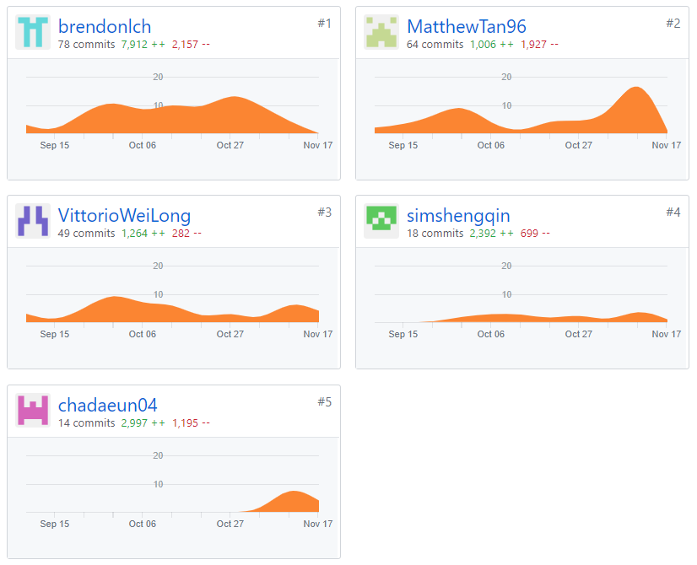

Slide 16
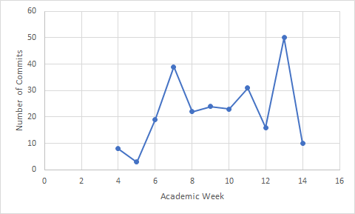
Spread of commits

Slide 17
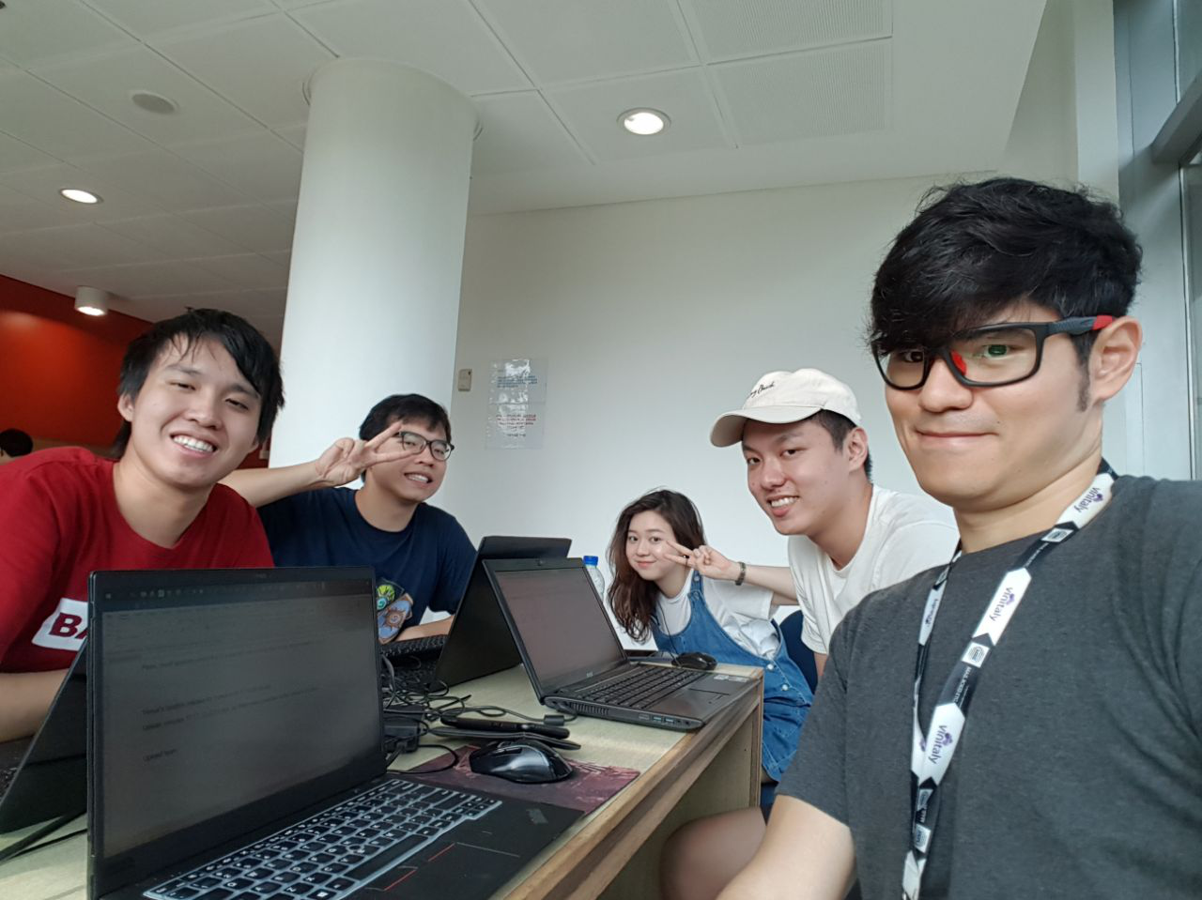
Reflections

Slide 18
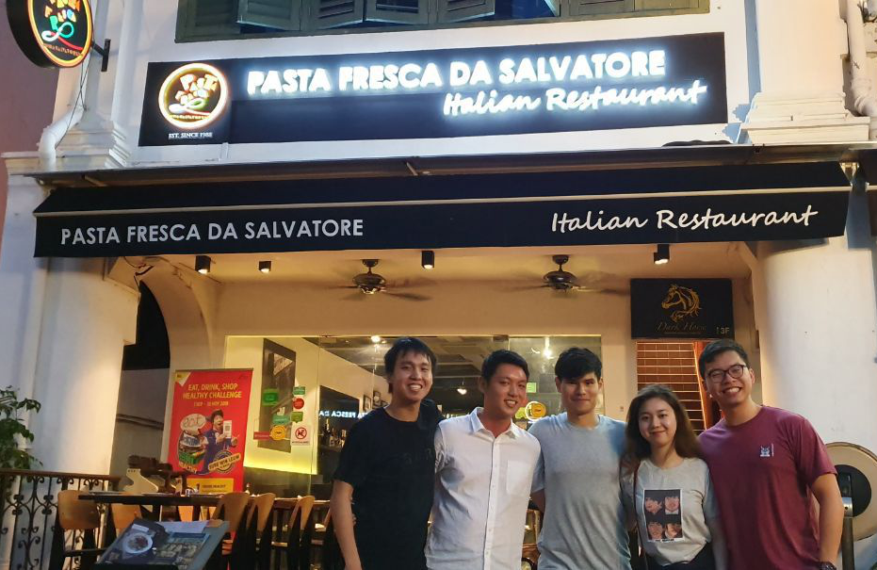

Slide 19
It wasn’t all smooth sailing...
Different priorities:
  Frontend vs Backend
  Looking at the big picture vs focusing on our current problems
Pair programming
Variable naming

Slide 20
Lessons Learnt - Traits of a good PM
Be meticulous with your scheduling
Try to have good communication with your team
Be committed to your DU and scheduling

Slide 21
Thank you!

